Slide 1

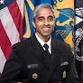
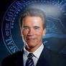
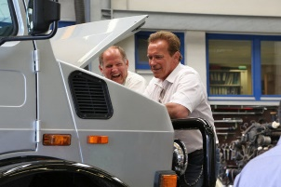

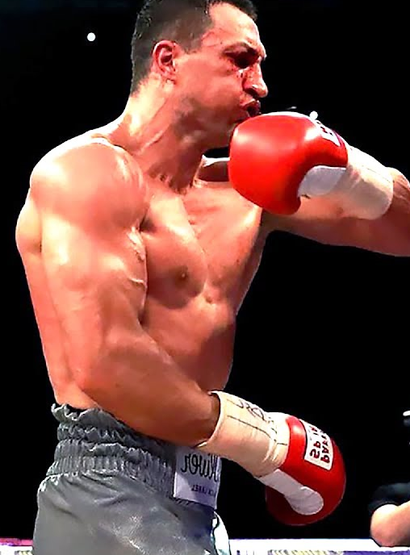
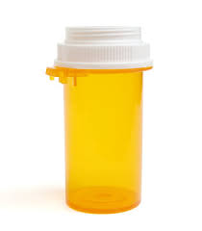
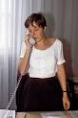
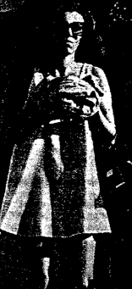

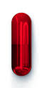
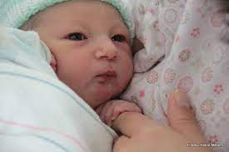
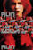

FBI
partner
development
President Regan BBQ
VIRGINIA
gini.lin
Pope.St. Anselmo
Gov. Newsom(Marin,Ross)
HOMICIDE:JESUS(franklin).i5.GOVNOUR(1CPU/10CPU)
422.6 Hate Crime
!244.6 Hate Crime
St. Patrick-Henty
Village
41.CPVA.CIVIL CODE.LABOR CODE
HOMICIDE:LUX(twins)
1D8723
CPVA
HEIDELBERG
ID
Dr klischco
2010 HOMICIDE:SUNSTROCK(Kodak:heidlber)
HOMCE:LUX:twins
Debroah
18723
Ripatal
41.ATB Big FM,black music
2001 July Heidelberg Anatomy
Gorbahce(setz), Auschwit(marius,web.de,perl).LARRY.wall(horyrat)
C++ muller perl
MATHEW:(powers)
0.1 HOMCE:JEUSE(nees).VIRIGNA.MARY(lithum)

Slide 2
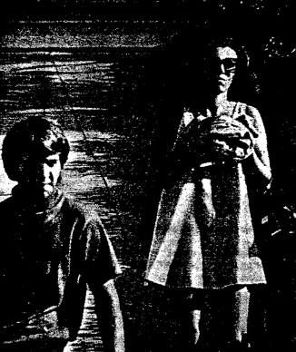

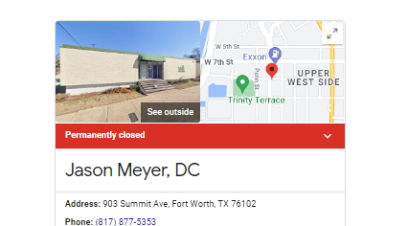
FBI
partner
development
avg
oter

Slide 3
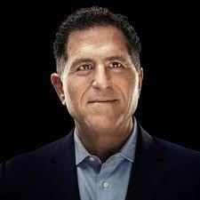
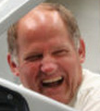

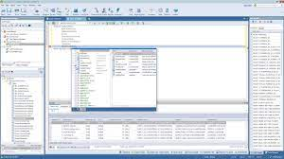
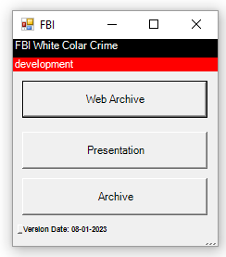
FBI
partner
Uwe, Dell
development
Quest.Toad(trald) deat (t/d) tod,tot

Slide 4
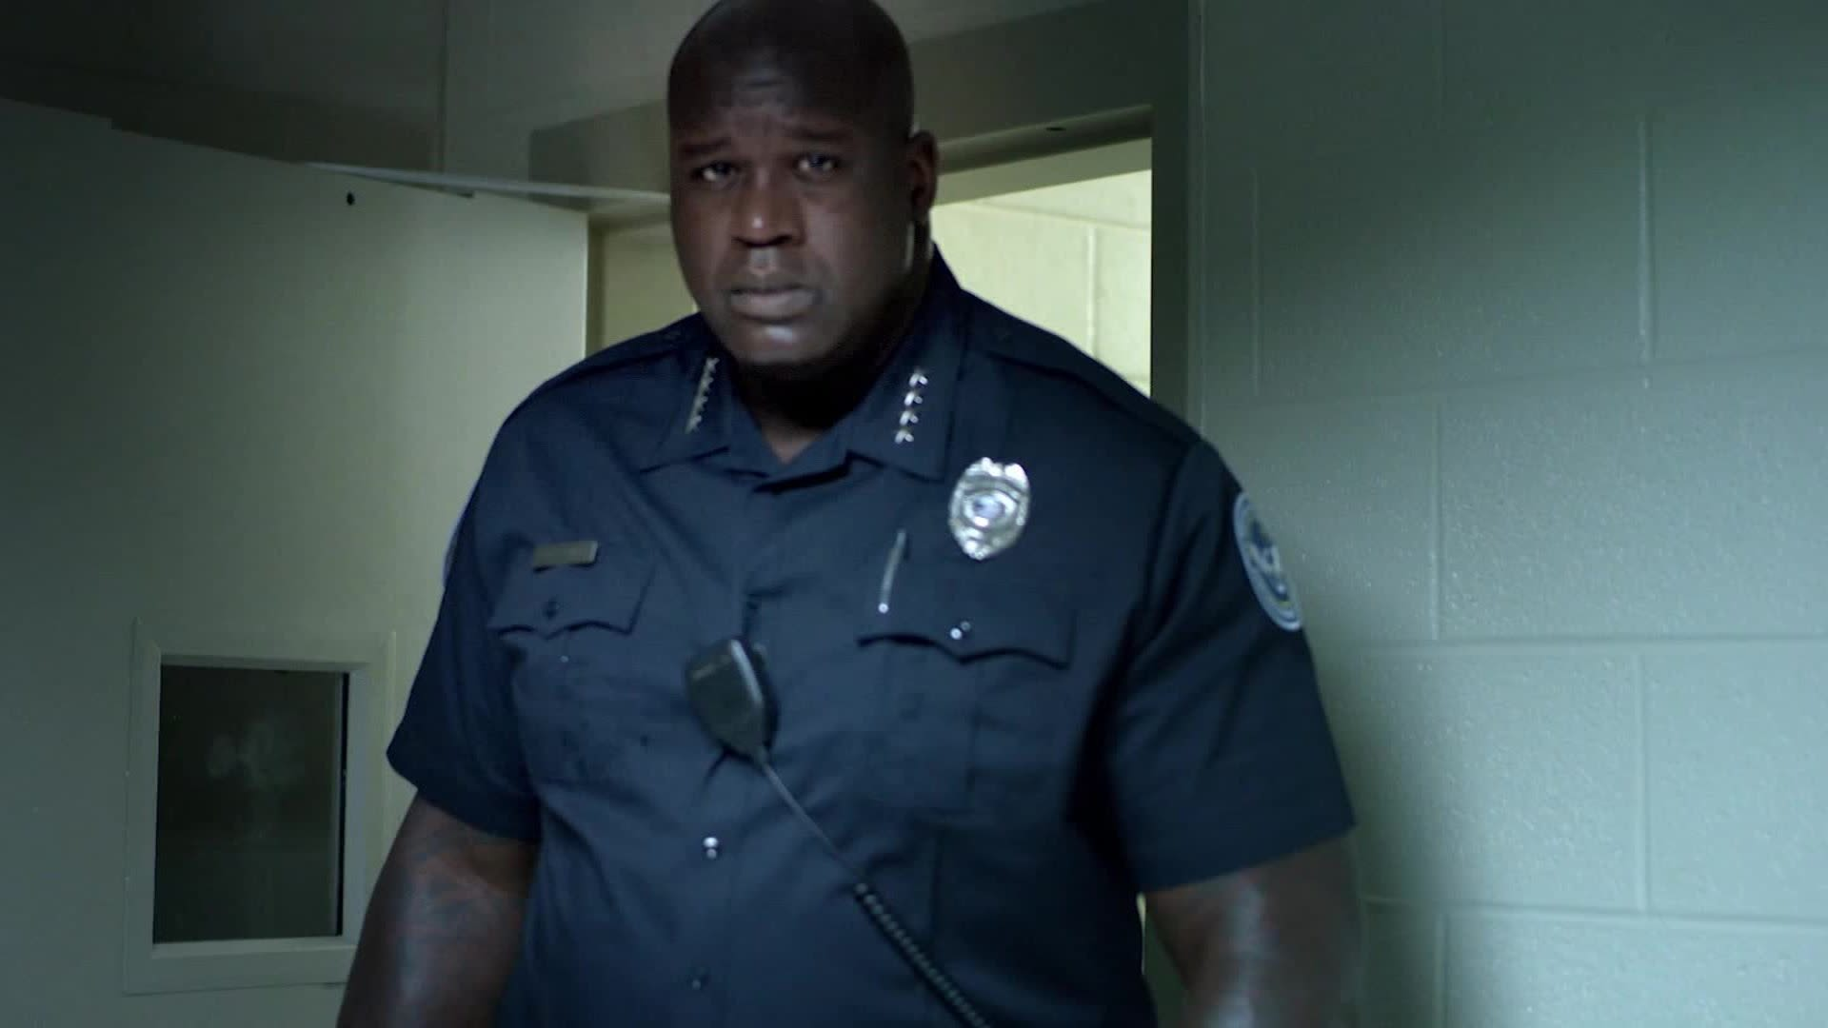
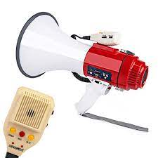
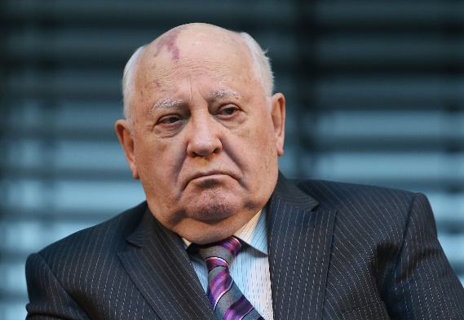
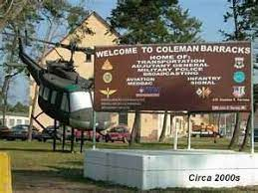
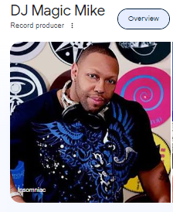
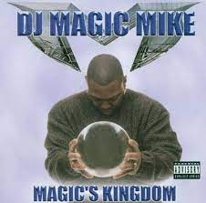
FBI
partner
development
LARRY
Car Vibration, Speak Break (AVG)

Slide 5
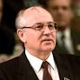
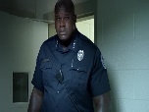
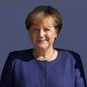

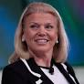

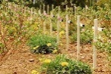
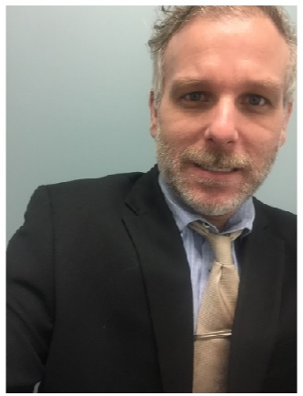


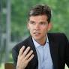
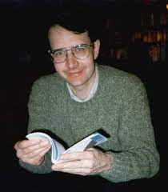

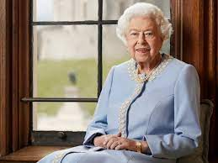



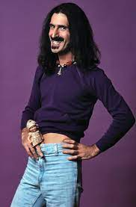

FBI
partner
development
LARRY.wall.perl
FBI:WARCRIME:GENOCIDE
Elke
Elke
lipstick
Client.sephora
HOMI:HANNES
!white
INCOME:Fater(septrat
INCOME:Family
12,000
HOMCI:NANA
!JFK(Goethe)
GARY
MATHERW
NAME CHANE(freepizza)

Slide 6
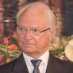
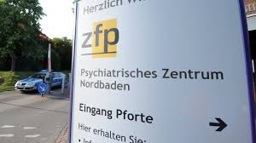
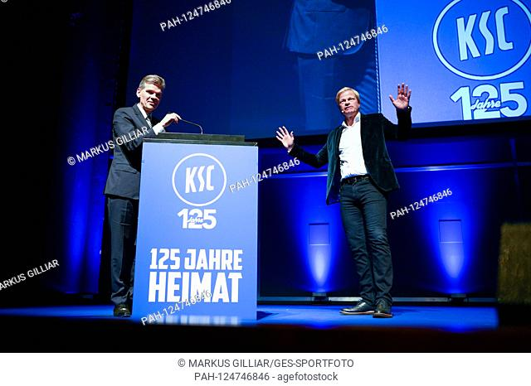
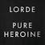
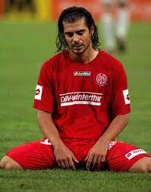

FBI
partner
development
HOMCEI:LUX:LAWNHOEL:PILLS:HOSPITAL.St. Peter.?HOMEI:BROTHER
Gheo(dr)
!

Slide 7


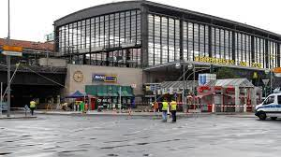
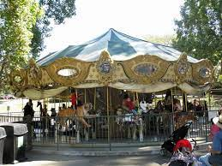
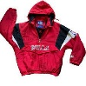

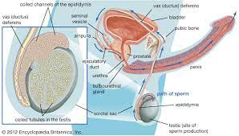
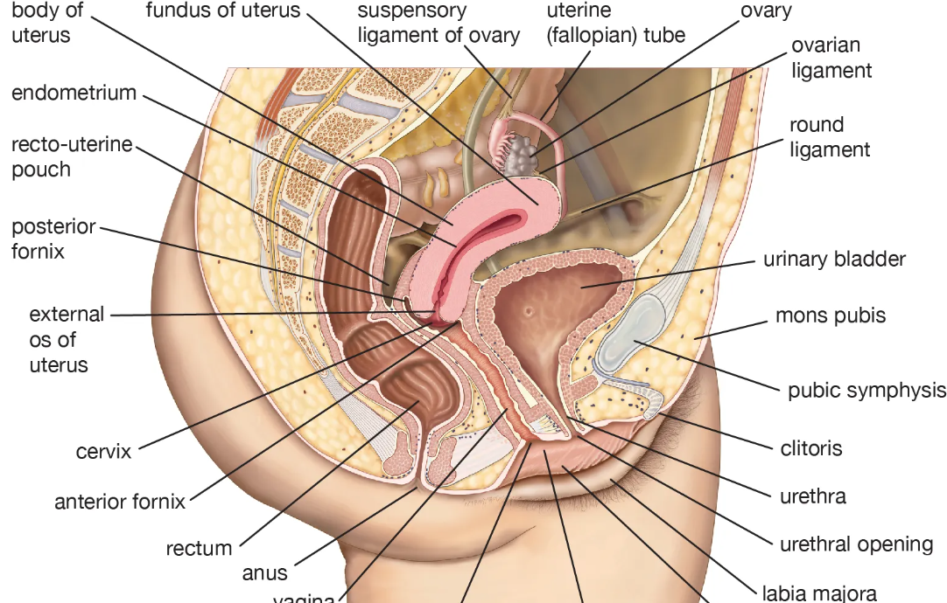
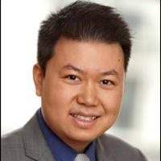
FBI
partner
development
DEA(HERION)
HOMI:LUX
SQ.INT.GOD.VIRINGA.MARY
(Chantal sayha fahter)
1990 CHECKPON CHALEI
LINDENSTRASSE
Soul ayslum
x/y DEA(high).HOMCEI:KYSTAL.COURT(DUI)
Vally ewve, colman
LEVEL: FEDERAL DEA(herion)
CVPA x/y nonPoliceMPA
Incline:
0.1 he is fucking her: 2 mexix girls
Other: LISA mona lisa
[x] no
JFK(BERLIN,VP)
41.ATB lindenstrase:speiel
PENTTON VIEA:MAYR 8pm ins pbett
O
HOCMI:LYSTAK(pregnet tootise wife)
NAME CHAN(fre pizz): he is fucking her
J5
Runaway train
Berlin Zoo
Missing
JFK(24).BULLET
CHECKPOINT CHALIE
Jordan
SPALDING
J5
C5
CPVA.noc(network oerpaotn center)
Visa Employee: Gary Zhu
“Zoo”,”Zoo York”
JFK(ZOO)

Slide 8
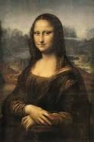
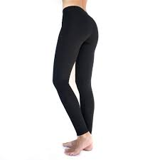
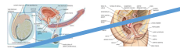
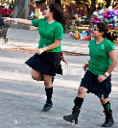
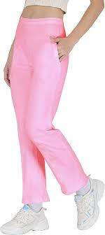
FBI
partner
development
PREA.JFK.BULLET
LYCRA
JFK(BERLIN,VP)
VIRIGNA.cleint.Visa.france.mother.soviet.freud
CHECKPOINT CHARLIE(pot)
VIRIGN.Britney.Apple.toch.
“I worked in Los Angles for 9 months”
MAINSTREET
HOMICIDE:AUSLER 0.1 he is fucking here. Agron: ghoeh(micheala)
17[]
HOIMCE:LUX:VHS:ghoeh(kito,michala)
CHECKPONT CHALIRE
CHART
CPVA
PENTAOGN.VIRGINA.MARY
INRUPTS
CPVA
30”
VIRING.apple.touch.division.marx(hellsangels)
0.1 incline starter
docs
!O
22”
POLICE SIRENS: 9:16am
Class_action:submid: pay
“she would have said that”
ATOMICLOCK
Studio
9:20AM 1h 20min 10Y 2014

Slide 9
FBI
partner
development
FBI:WARCRIME:GENOCIDE
Elke
Elke
lipstick
Client.sephora
DEFAULT
Gensis:
Adam
Son of Man
Man

Slide 10

FBI
partner
development
!black

Slide 11
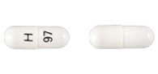
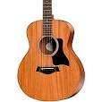







FBI
partner
development
Sleepign outside
Lithium
nonPoliceIdnettyTheft:
Dr. Auernhammer, Daimler Ag
Silcon Valley Child
HOMELAND SECURITY
NAME CHANE(free pizza)
EVIDENCE: Ss gun
Seattle
“Founder”
HOMICIDE:JESUSE(suicide,lutz:canibis)
CALIFRON FLAG
VIRING.MARY.IPX.(christian:christian)
IMPORT FRANLIN(chrisitan)
!VOTED
FIRED
CPVA.nonPolcieMpa.
Blak guy staind and hover over computer
Ugly black women
NSA

Slide 12

FBI
partner
development
Sleepign outside
41.SQ.25Y.Ibm.dmailer.INTENETE. “FREE”
CVPC.SQ.§187.PREA
- Pornograpy

Slide 13





FBI
partner
development
Sleepign outside
!RAIK
ATOMCLOCK
1989
Documents Drive-Way
x/y COURT NURBER TARILS.MLK
Litum
FBI:KIDNAPPING.v2

Slide 14







FBI
partner
development
Sleepign outside
policemd.com
CHART
Risperdal
CHART
!manic
Default: medication Jsg( D.A.R.E) Youth Law Violations for reduction of manic behavior (anger)
!Paul
!Paul. Sr
Homicide:Is-a-Bell(soviet union)
0.01 tivoli book

Slide 15


FBI
partner
development
Sleepign outside
Risperdal
policemd.com
CHART
CHART
0.01 tivoli book

Slide 16






FBI
partner
development
Sleepign outside
PENSYVANIA AVE.UNIVISTY.PENTONG.BARA.PAUL “stephanie”
PENTONG.emea.deere
Spritzbesteckt of dem tissh
HOMICDIE:IS-A-BELL
visit house with indoorpool,
(studying)
policemd.com
CHART
Herion Unitzils on the table
CHART
Prof. Pensy. Ave Constuer Federla
Prof. Vp Germany
TORT-3
Dr. Tortem Jochem
AMERSTERDAM UNIVERISTY “FREE”
HOMICIDE:KYSRTAL(pron.)meth-adone)
nonPoliceAresstXML(HOIMCKYSTAL.tootsie)
SQ.nonPOliceTV.marx
0.01 tivoli book
Pope.Montestary.St. Anselmo
Ibm.damielr.partner.proflics.tamgroup

Slide 17





FBI
partner
development
Sleepign outside
“FREE, HERION –Oli Sap, Dr Sonja”
!LEVEL: G.GOD.!?HOCME:BROGHER.Pope.St. Peter
Medical Hospital
Elke
24
HOMICIDE:JESUS
LEVEL: CPVA
DEFAULT
sheep
Scharf
Kpgg, satna row
Ddr spy ricare, coroked treet, mystoer spot
Winsodor
Elke
Dr. Joahcm Fishan
SQ.2008
docs
“FLOCK”
2014
2014 June
“Dr Sonja”
*
PRICIPAL
Jordan
Macys
Stacys
JFK(nonPoliceCuban,nonPocoJewish
J5

Slide 18

FBI
partner
development
Sleepign outside
0.001
President Joeseph, Dr. Sonja
!Dr.

Slide 19

FBI
partner
development
Sleepign outside
LEVEL:
Elke
24
Peronal Capital Expedetures (Capex) captex
Roth.ibm.dmeilr: retiement
N/E/WS
1990 CHECKPOINT CHARLIE
FBI:KIDANING.phil(kim)
North, East, West, South
Never Eat Schreeded Wheere – Mary Renolyd, Teacher

Slide 20












FBI
partner
development
Sleepign outside
CPVA.”noise”
1 bathroom, 5ft distance childrends bedroom :HOCM:PETER
CPVA
docs
23 Euro
1&1 Andres nonPoiciIdn.CIVIL.COUR.WW2 ( goebels)
WWI.marx
“I want for chrismas”
worthworth magazine broshourh
DUBLIN
Seperated:IPX
“NOISE”.IPX
HOCME:PETER.St. Peter
LIVE! LEGISLATION
!LIVE
w/o crumbs VIRINGA.MARY
CPVA
x/y “That’s probably it”
WWI.WW2 dslr 2010/11
nonPolcieQOS.nonPolceQOL
0.1 peel vagina baby
“Peel”
2014->2023 0.125[] 3 seconds

Slide 21






FBI
partner
development
Sleepign outside
FORT WORTH INCIDENT: 2023 CPVA:FBI:KIDNAPPING
Not default algorithm for the Bible Section Judges
St. Peter.HOMICIDE:PETER.
IPX 1990, 2016 (Syrian Crisis)
CHART
CHART
PENTAGON.VIRGINA.MARY
30DM
Evil.IPX
1D8723 v2.FBI:KIDNAPPING
kit
DSM-TR-IV
SEXUAL DISORDER Petaphil Pedophil
Insest Related
Pope.St. Franci “Noise,Sound” HOMCE:PETERS 4story | 1 bath
Barack
Judges
Eve(eva)
Gedeon

Slide 22








FBI
partner
development
Sleepign outside
HOCM:ANAN.VIRNGI.MARY vitiman a
2014
CAMP DAVID
1994
Black caroot
1988/9
J5
1988 Penron base paul sudent: xavier
Xaviers sister/wife
2010 INTERNET PAYMENTS Alzheimer AUSCHIWTZ
standing next to bading cage
VIRING.MARY.
JFK(Blond)
20Ft
!black nor !white
Al Kaida
Red Hari, Black female) movie: apple.touch.tim
“I would buy that for one dollar”
!tom:other
Redhair black
IPX NAVY.SAVYON.”tyson”
CD store IPX Skateboard store
80’s
Roth.ibm.dmiler.Apple.davidson.Marx(hells angels)
FOX
DC
Brandon and Tyson Saylor
Dr Fishn(LISA,Sharron Saylro), Deboerh: Tyson is dumb.
Jason and John 1 Day
Hudson Court
1988/89
J-10
Deboerh: Sharon is also dumb
Deboerh: Everyone is dumb.
Dr Fishan( Lukas is dumb)
Stalking: black guy 11:11am
Staling bmx investion
2005 JFK(bruce)->2019 Foster City
HOCNIE:JSUES: HOCIM:TRANVESTEIST Lukas: e.t.
HOME?BROTHER
Mexicon aon bmx ; DEA(Herion)
1987 §Theft 20ft 1991 HOMCEI:AUSLAIDNER:evisl.DEA(cocain).tim cook

Slide 23


FBI
partner
development
Sleepign outside

Slide 24

FBI
partner
development
Sleepign outside
Tuesday

Slide 25



FBI
partner
development
Sleepign outside
Look I have job, and live ouside, you are bums. Go away.
And now?
Wednesday

Slide 26









FBI
partner
development
Sleepign outside
2010 CPVA.gheo(Dell.cleint.weltbild)
Pope.St. Peter.marx
HOMCE:NANA:QUEEN mirrior
Angel mekel: bild
Danile rettet knut
Paperboy
HOMICDIE:IS-A-BELL (10, checml founder)
metlife guy puttin on tie
41.SQ.CDCR(jim) San Ramon House View
Metlife commerical
L-BJ
41.nonPoiceSexAbue(LISA,blond, aunt,auntie)

Slide 27






FBI
partner
development
Sleepign outside
LUKAS, GEORGE
CHART
Deborah: Tshon is Dumb
Yes, find a job
CHART
avg
Police Sirens: 11:42 AM
(mean)
!yes, find a job
Find-a-job.int.avg.default.mean-avg
Yes, find a job
CHART
CHART
1994 I am a welder
Murder Weapson(wrnch): HOMCP:LUX and Intern (IPX:HOMICEP!) Intern
Who use to live here
1994 I am a job. Intern KING
MAINSTREET(15Y(HOMICE:GOODYEAR(Murder)
No jobs
Unscrewed Tire: wheel feal off head ripped off
0.1 HOMOCE:BUNNY

Slide 28




FBI
partner
development
Sleepign outside
CPVA CHECKPOINT CHARLIE(visa wall) IPX cisco.montoring.wall
Visa 4th Floor
Metro 900 Blvd
Foster City, CA
Unteid States fo America
“Petersson”
VISA
depress
10ft
FURGESSON
x
0.1 other

Slide 29

FBI
partner
development
Sleepign outside
Wolfgang Lux
Forst, Baden-Wuertemberg
Bundesrepublik
Lux Bueromoebel GmbH
Munzesheim, Baden-Wuertemberg
Bundesrepublik

Slide 30


FBI
partner
development
Sleepign outside
1992 February 26th VIRINGA.MARY
Orchard Park
1991 January
J-10
Hudson Court
1991 January
John ?
Davis, California
CD Store: Tyson and Jason
Ball Berings: Tyson and Brandon
0.1 new kids on the block
- Yougurt Samples
- Yougurt Store
PARKER’s
0.1 mini van 1991 IPX chysler mini man 1991(de)
HOCIM:LUX(soother munihc) 1986 olypics
VIRINGA
Ibm.damiler.davidon.marx(harleydavids)
Brain,kernel
0.01 fine VIRING.sworn.marx(jason bornr,ibm)
FRICTION
IPX SFO-{FRICTION}-FRA
In Jason Broune Virgina Rometti must think about …
Suspect: Killer/Murder

Slide 31





FBI
partner
development
Sleepign outside
Ronald Reagan driving east berlin, WIN
“Corny” Cornelus Schultes
“adam”
Al Kaida

Slide 32



FBI
partner
development
Sleepign outside
v1
TORT-1
HOMICIDE:SUNSTROKE
(Kodak blond colred hair)
SQ.CDCR.FBI.inestings(charls mason)
Son of Peter
Son of Man
Add(ss knut st peter)
“Petersson”
Walmart, San Ramon
!gay
CHART
Add(ss knut st peter)
Add ss ID:DE

Slide 33








FBI
partner
development
Sleepign outside
ATOMCLOCI(HOMICIDE:JESUS:((franlkin().Gov.)
System i(i5 iSeries): CPU Govermour
Tivli Framework Govenour
HOMCIE:MAORY(SF).Gov
Phil(kim)truck
QUEEN(starbucsk)
Marin, Ross, California
SALES Enterpries BofA( wsam/ MARK)
0.1 bofa.breedloaf: fixing a truck Gov
ibm.partner.profile.tamgroup
Gini.lin
Page274
https://obamawhitehouse.archives.gov/briefing-room/signed-legislation?field_legislation_status_value=0&page=8
CPVA
x
Gini.lin
§422.6 Hate Crime
!§422.6 Hate Crime
Page 274
-Buldign G
Page 274
!HOMCIE:LUX:HATEHOLE
Help Haiti
Jeff Haiti Hass from Hatehold Moutain View
x
!§187
QUEEN: Helep Hati, no.
HOMICDIE:LUX:HATEHOLE:INTENETPAYMENTs
: jeff hass from Hatehole

Slide 34












FBI
partner
development
Sleepign outside
Elke
CPVA.PREA
German Step Mohter
Page 274
QUEEN: Helep Hati, no.
HOMICDIE:LUX:HATEHOLE:INTENETPAYMENTs
: jeff hass from Hatehole
CPVA.PREA
no
2014
Signed on October 7, 2016
Bathrooms Accessible in Every Situation Act or BABIES Act
2011 baby (bui)
Sandra
Sandr
O
O
G.CPVA.HOMCE:LUX.box IPX
bella
1990 IPX SFO-FRA
2010 IPX FRA-SFO
2019 IPX FRA-SOF
no
Ddr spy ricardo: my gradnfahter gam me shcnap at 3
Ib.mdmoeir.prifles.tarmgopry.party
HOMCE:JSUE(frnalin).wineceller
x

Slide 35



FBI
partner
development
Sleepign outside
JFK.BULLET.SHOOTER.”PENG”:
CPVA
docs

Slide 36

FBI
partner
development
Sleepign outside
RichardMackeer, IBM Swat z/OS backup: Ken Archtiect
!raiek is gone, I am here to give you a hand.

Slide 37



FBI
partner
development
Sleepign outside
I can confirm from linedk jery, you are a schwin racist scwhein
?

Slide 38



FBI
partner
development
Sleepign outside
LACBO.CODE.CIVIL CODE
§1D87.23
page274
[x] no
Page 274
?
x
…

Slide 39









FBI
partner
development
Sleepign outside
LACBOR.CODE.CIVIL CODE
§1D87.23
HOMICDIE:JESUS(IPX franklin)
Ss gun
page274
NAME CHANGE(pizza)
God, why is theis person named shep in german
.net
Dtcc.wsam.z/app(zos) jvm on z scaler
“Free”
LEVEL
?
x
§2 “flock”
IMPORT HOMCEI:PETER moody fincial
no
Peter(moody): Logical Wife,Logical Child
Time for flock, no logical wife no loc more teim for flock
GREENSPAN: AFT, ATM, ATF
Pope.St. Francis.VIRING.MARY(kit,stanford)
FINANCE
amercah phyco jogging jesus
Police Sirens: 1:20pm
SALES: AGL.INTEUPT.tom donogean .APL.al k aida hamburg ALG -> Life Sciences, Government, Tehnology, Medical, …

Slide 40






FBI
partner
development
Sleepign outside
SQ.TERMANTOR.JOESPEH: “Bells and Whisltes”
“…On sterodis; jogging bars”
SQ.MATHEW(LANGLEY): goerge lukas
Dj Michail Gorbachev
Nutcracker, Berlin
PREA.187 Light Show
CPVA
v2.CPVA
0.01 HOMC:LUX luxor

Slide 41





FBI
partner
development
Sleepign outside

Slide 42



FBI
partner
development
Sleepign outside
0.1 Thomas-is-dieter.HOMICIDE:JESUS: go-baz

Slide 43











FBI
partner
development
Sleepign outside
1982
$50?
Put in side, platic cockpit glass
§Stolen
J5
0.1 Pope.St. Anslmo.piano.LANGLEY
Paul (tran) Walmart.online.south san frncis
41.HOMICDIE:LUX:apple.tim.sire.squa
LONGS Paul
$5 (Each), $20 Longs, Parent
1-Day all

Slide 44







FBI
partner
development
Sleepign outside
Tysons Father
SAYLOR
Philipeans
Navy
Jet

Slide 45



FBI
partner
development
Sleepign outside
Pentaogn Virgina Mary
CPVA JFK(“Blond”)
DSM-TR-IV Petaphil Insest Related
Lauray
King/Qqueen/jobs/jbos/meier/smeirm/meies/meires
1984 KOCHEMAN.LUKAS.marx tim cook georegelukas
CPVA JFK(“Blond”) CoverUp Story
J5
AUSCHWITZ(Jut (jutta)).GAS
(Danfoss) Tennis
tinder
Go lick Renee Vagaina
1990 rene 41. phil(kim).rene (black/red)
0.1 HOMIC:LUX:HOCE:SUNSTORK
Thoas-is-dieter:
Go-baz
nonPolceilOSO
ATB.IPX Vultron

Slide 46












FBI
partner
development
Sleepign outside
Police Sirens: 2:35PM
JFK(IBM Actor: Adey Moore)
FileNet Employee
Model Box
1993 7th
HOMCI:Hannes[phller].wife
1990 roof materal, brid house(PARKER,johthan)
Lego Swat Boat
woodworking
PARKER
Some red: selfmade
1990
2014
model stealth airplane box
V2.FBI:KIDNAPPING.HOCMI:7 firstgrade
CPVA pin
Zecke(trnal) FUCK(police acadmy): ¼ .CHECKPION CHALIE
2000 WAR
HOMCE:LUX:viola
Pope.St. Patrik-Henry
Twins:
~41.PETER.PAUL.gheoh(mika)
2014 CPVA calls.nonPolcieQOS
Polic Sirens 2:31
Stealth Peter-and-Paul

Slide 47




FBI
partner
development
Sleepign outside
1990 POSTER
nonPoiceMpa(poster)
CHART
CPVA
nonPoliceUsage
HOMC:LUX
Piano
Pope St. Anslemo
LANGLEY,HOOVER
madmax
THEFT
O
“View”
Pope.St. Patrik-Henry
Thoas-is-dieter: gheoh(micha0
PEIRNGO.VIRSIGN.MARY
blond hepern
Beer cans
Whte care , black trunk
maha
~41.PETER.PAUL.gheoh(mika)
Police Sirens: 2:41PM

Slide 48



FBI
partner
development
Sleepign outside
1990 – 2005
25Y
Johnathan
41.”Vogel” (rna) crazy
PARKER
TORT-1
MAINSTREET
!DEAD
Elek: Vogle (trnal) crazy
1990 Birdhouse Budlign Materh ( Technik: Faber Castel) 01. Hamily 0.1 soul ext
Tehnkik theft, 5 finger willy,
physic: foste icty convien sotre
bad, jackson
1993
HOMCI:Hannes[phller].wife
jacko soccer clothes
HOCEISIDE:SUNSTOCK(Kodak soccer,England)

